Slide 1
DevOps Training Mercedes
9-12 April, 2019
Albert Anthony

Slide 2
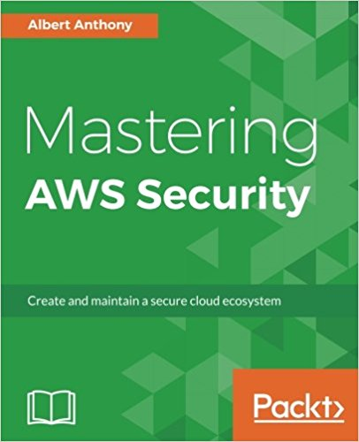
Introductions
Founder of Loves Cloud (www.loves.cloud)
Trainer & Consultant
Containers, DevOps, Cloud & Serverless
Author – Mastering AWS Security

Slide 3
Setting Expectations
Topics Covered
GitHub Hands-On (5 Labs)
Jenkins Hands-On (6 Labs)
Docker Hands-On (7 Labs)
Kubernetes Hands-On (4 Labs)
22 Hands-on Labs

Slide 4
Pre-requisites
Putty/GitBash on Laptop to Connect to Remote Server
Internet – HotSpot to Connect to Remote Server
Resources:
Launching Your Own Server in Cloud
GitHub Account
Docker Hub Account

Slide 5
Training Methodology
Less theory, more labs
Fully functional environment for all participants
Servers and software pre-installed
Hands-on labs for all topics
Team and individual assignments
Best Practices
Lab instructions document
Labs similar to real projects
All training material to be shared with participants

Slide 6
Training Schedule – Day 1
Introductions
Setting Expectations
Overview of Training
Launching Your Own Servers in AWS
Overview of DevOps
GitHub Hands-on

Slide 7
Training Schedule – Day 2
GitHub Collaboration
Jenkins Hands-On
Basic Jobs
GitHub Integration
Continuous Integration
Continuous Deployment
Pipelines

Slide 8
Training Schedule – Day 3
Docker Hands-on
Images and Containers
Running Containers
Dockerfile
Dockerize Apps
DockerHub

Slide 9
Training Schedule – Day 4
Docker Compose
CI/CD Pipelines Using Jenkins and Docker
Group Assignment
Kubernetes Overview
Deploy Dockerized Apps on K8 Cluster
Monitor Kubernetes Cluster with Prometheus and Grafana

Slide 10
Download Lab Instructions
https://github.com/albertlovescloud/mercedestraining

